Slide 1
CAPSTONE PROJECT
Image Steganography Tool
Presented By:
Student Name : SIVANANDH CC
College Name & Department : ERODE SENGUNTHAR ENGINEERING COLLEGE, COMPUTER SCIENCE AND ENGINEERING DEPARTMENT

Slide 2
OUTLINE
Problem Statement
Technology used
Wow factor
End users
Result
Conclusion
Git-hub Link
Future scope

Slide 3
Problem Statement
"In today’s digital age, securing sensitive information is a major concern. Traditional methods of data encryption are often complex and not user-friendly. This project aims to develop an Image Steganography Tool that allows users to hide secret messages within images securely and retrieve them effortlessly. The tool ensures data security while maintaining ease of use for non-technical users."

Slide 4
Technology used
Programming Language: Python
Libraries: OpenCV, Tkinter
Platform: Cross-platform (Windows, macOS, Linux)
Tools: Visual Studio Code, Git
Other: Image Processing, GUI Development

Slide 5
Wow factors
Unique Features:
User-Friendly Interface: Built with Tkinter for seamless interaction.
Password Protection: Ensures only authorized users can decrypt the message.
Cross-Platform Compatibility: Works on Windows, macOS, and Linux.
Efficient Encryption: Hides messages in image pixels without noticeable distortion.
Open Source: Fully customizable and available on GitHub for collaboration.

Slide 6
End users
Individuals: For personal use to secure sensitive information.
Organizations: For secure communication within teams.
Researchers: For studying steganography and image processing techniques.
Students: For learning and implementing steganography concepts.

Slide 7
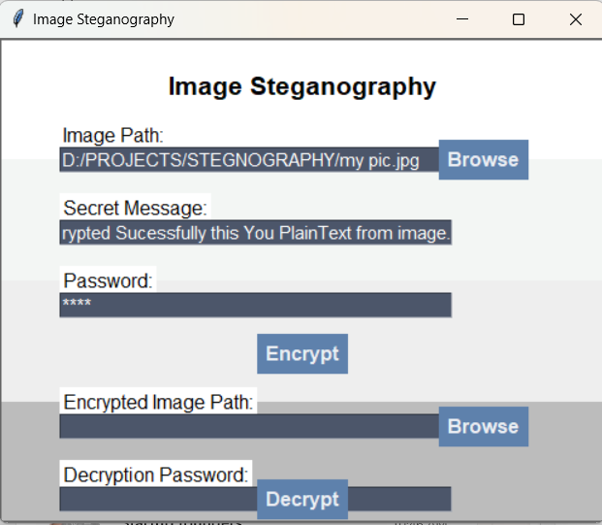
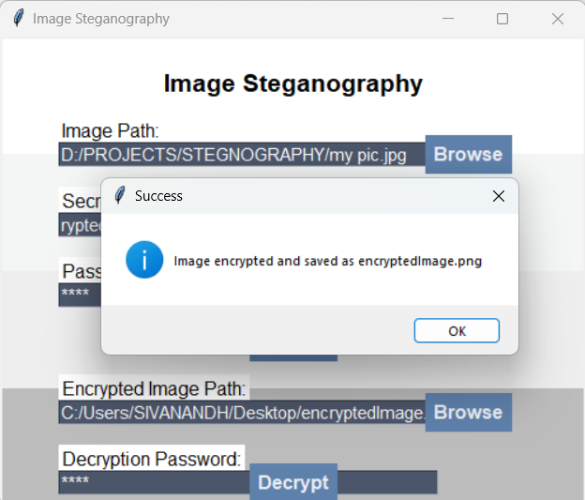
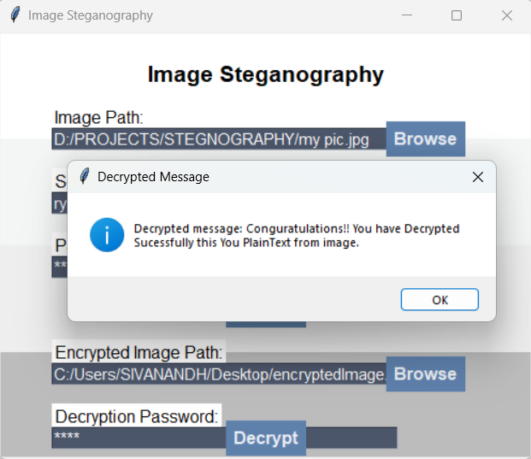
Results
NORMAL INTERFACE
ENCRYPTION
DECRYPTION

Slide 8
Conclusion
The Image Steganography Tool successfully addresses the problem of secure data transmission by hiding messages within images.
The project demonstrates the effective use of Python libraries like OpenCV and Tkinter to create a user-friendly and secure application.
It provides a practical solution for individuals and organizations to protect sensitive information effortlessly.

Slide 9
GitHub Link
GitHub Repository: https://github.com/Sivanandh10/STEGNOGRAPHY
README File: Includes detailed instructions, screenshots, and usage guidelines.

Slide 10
Future scope(optional)
Enhancements:
Add support for more image formats (e.g., BMP, TIFF).
Implement advanced encryption algorithms for higher security.
Develop a mobile version of the tool for Android and iOS.
Integrate cloud storage for saving and sharing encrypted images.

Slide 11



THANK YOU

